Slide 1
INTRO TO
LANGUAGES
The Programming club, IITI

Slide 2
ABOUT RECRUITMENT
THE PROGRAMMING CLUB
DEVELOPMENT
COMPETITIVE PROGRAMMING
(CP)

Slide 3
700 programming languages
What languages are worth learning in 2020?
C++,Python,Java etc..

Slide 4
700 programming languages
Can you list 10 programming languages?
Python,Java,C++,C,C#,JavaScript,Kotlin,GO,Ruby,Dart and many more.

Slide 5
700 programming languages
Is ::HTML:: a programming language?
HTML, as a markup language doesn't really “do” anything in the sense that a programming language does. HTML contains no programming logic. It doesn't have common conditional statements such as If/Else. ... This is because HTML is not a programming language.

Slide 6
Compiled vs Interpreted
C++ vs Python
Python is much more beginner-friendly, while C++ is a more complicated, low-level language. C++ has more syntax rules and other programming conventions, while Python aims to imitate the regular English language.
When it comes to their use cases, Python is the leading language for machine learning and data analysis, and C++ is the best option for game development and large systems.

Slide 7
Compiled vs Interpreted
Compiler: Parses whole code in one go. And shouts out errors at the end :/
In a compiled language, the target machine directly translates the program.

Slide 8
Compiled vs Interpreted
interpreter: Parses line by line. And shouts out errors then and there :0
In an interpreted language, the source code is not directly translated by the target machine. Instead, a different program, aka the interpreter, reads and executes the code.

Slide 9
Structured programming vs OOPS
NOTE: this is important topic for interview purpose !
First the perfect examples:
C
Php (< 5)
FORTRAN
=====================
STRUCTURED LANGUAGES

Slide 10
Structured programming vs OOPS
First the perfect examples:
C++
JAVA
PYTHON
=====================
OBJECT ORIENTED LANGUAGES

Slide 11
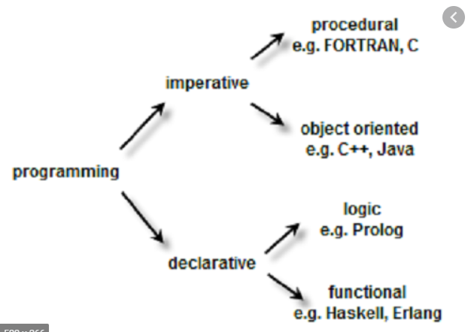
Structured programming vs OOPS

Slide 12
Structured programming vs OOPS
OOPS
Classes
// add your explanation
A class in C++ is the building block, that leads to Object-Oriented programming. It is a user-defined data type, which holds its own data members and member functions, which can be accessed and used by creating an instance of that class. A C++ class is like a blueprint for an object.
Q) describe Cars as classes?
Consider the Class of Cars. There may be many cars with different names and brand but all of them will share some common properties like all of them will have 4 wheels, Speed Limit, Mileage range etc. So here, Car is the class and wheels, speed limits, mileage are their properties.

Slide 13
Structured programming vs OOPS
// add your explaination
The main difference between structured and object oriented programming is that structured programming allows developing a program using a set of modules or functions, while object oriented programming allows constructing a program using a set of objects and their interactions.

Slide 14
C++
// info about c++ etc
About C++ Programming
General Purpose Language - You can use C++ to develop games, desktop apps, operating systems, and so on.
Speed - Like C programming, the performance of optimized C++ code is exceptional.
Object-oriented - C++ allows you to divide complex problems into smaller sets by using objects.
Competitive Programming-C++ is the most popular language in competitive programming.

Slide 15
C++
/*
Points to explain
What are datatypes
Functions
Algorithms
*/

Slide 16
C++
Data types:- int,double ,float,bool,char,string,arrays,structs Some basic functionalities:- cout<<”Hello World!”; // is used to end the line
int x;//here we have declared a variable
cin>>x;//for taking user inputs we write like this // is used for comments :)

Slide 17
C++
Conditional Statements:-
if ( 1<0 )//here we write the conditions in the form of statements which can be T/F.
{
cout<<”Hello World!”;
}
else
{
cout<<”BYE”;
}

Slide 18
C++
For Loops:-
Print nos. till 10
for(int i=1 //initialization ; i<=10//Here the condition comes ; i++//iteration_expression)
{
cout<<i<<endl; //code goes here
//At the end the iteration expression runs i.e i++ in this case
}

Slide 19
C++
While Loops:-
Print nos till 10;
int i=10;//Here the initialization comes before the while loop
while(i>0)//Here the condition comes {
cout<<i<<endl;
i--;//or we can also write i=i-1;
}
Now You are Ready to dive in :)

Slide 20
PYTHON
The FAB of 21st century
Created in 1980s in Netherlands
# Super Language
Fun thing to note is python multithreading is fake. Absolute fake!
Read more here -
https://realpython.com/python-gil/

Slide 21
PYTHON
SYNTAX:
You don’t have to think much in python
Open IDLE to get Started! :)

Slide 22
PYTHON
> > > print ("open your %s please"%("idle"))

Slide 23
PYTHON
PRINT FORMATTING
> > > print ("open your %d please"%(1))
> > > print ("open your %0.3lf please"%(3.14156877))
> > > print ("open your %10.3lf please"%(3.14156877))

Slide 24
PYTHON
Common functions are:
print()
input()
help()

Slide 25
PYTHON
Define your own functions
def add(i,j):
ans = i+j
return (ans)
print(add(1,2), end = "\n")

Slide 26
PYTHON
Datatypes
String
Int
Float
Char
=============

Slide 27
PYTHON
Other Data types
List
Tuples
Dictionary

Slide 28
PYTHON
String methods
Split
Strip
Join
>>>str[:-1]
>>>str[::2]

Slide 29
Final - Solving a problem
Solve this https://codeforces.com/contest/1415/problem/A

Slide 30
JAVA
100% Object Oriented
DATATYPES
Int, char, float, boolean
String

Slide 31
JAVA
import java.util.*;
public class Main{
public static void main(String[] args) {
Scanner sc = new Scanner(System.in); // Use the Scanner class
/*
int n = sc.nextInt(); // read input as integer
long k = sc.nextLong(); // read input as long
double d = sc.nextDouble(); // read input as double
String str = sc.next(); // read input as String
String s = sc.nextLine(); // read whole line as String */
}
}

Slide 32
JAVA
Refer to this blog for CP in java:
https://codeforces.com/blog/entry/7018

Slide 33
JAVA
Tutorial for java :
https://www.javatpoint.com/java-tutorial
/*
We are going to discuss data structures in java.
*/

Slide 34
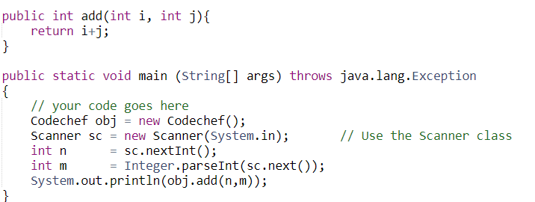
JAVA
Methods

Slide 35
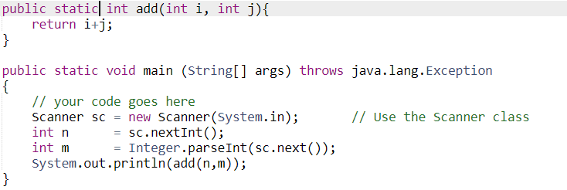
JAVA
METHODS (static)

Slide 36
JAVA
DATA-STRUCTURES
ARRAY
int []A=new int[5];//declaration and instantiation

Slide 37
JAVA
DATA-STRUCTURES
BEHOLD, Collections in Java 🔥🔥🔥
“With great power comes great responsibility”
Read it here
https://www.javatpoint.com/collections-in-java

Slide 38
JAVA
DATA-STRUCTURE
interfaces (Set, List, Queue, Deque)
classes (ArrayList, Vector, LinkedList, PriorityQueue, HashSet, LinkedHashSet, TreeSet).
“Don’t Break a sweat, You only need 3 things Arraylist, Hashset, set”

Slide 39
JAVA
DATA-STRUCTURES
Array-list
ArrayList<String> list=new ArrayList<String>();//Creating arraylist
Methods :
Add(), size() etc

Slide 40
JAVA
DATA-STRUCTURES
Hashmaps: key-value dictionary
HashMap<Integer,String> map=new HashMap<Integer,String>();//Creating HashMap
map.put(1,"Mango"); //Put elements in Map
map.put(2,"Apple");
map.put(3,"Banana");
map.put(4,"Grapes");

Slide 41
JAVA
Java is Hard to master!
One good use is for native android development!

Slide 42
GITHUB
Make an account on github please. To be explained in other workshops
What is GITHUB?
Free Storage UNLIMITED!!! Or is it?

Slide 43
FUN THINGS TO EXPLORE
“Coders, Your Sword is your terminal”
Open CMD in Windows
Open TERMINAL in LINUX
MAC-OS (Not a fan!. Maybe terminal?)

Slide 44
FUN THINGS TO EXPLORE
// open cmd in a folder or cd to it
Caution irreversible things handle with care!!
mkdir temp
cd temp
echo hello world

Slide 45
FUN THINGS TO EXPLORE
curl parrot.live

Slide 46
FUN THINGS TO EXPLORE
for linux users!
fortune | cowsay
This is why linux is so hyped!

Slide 47
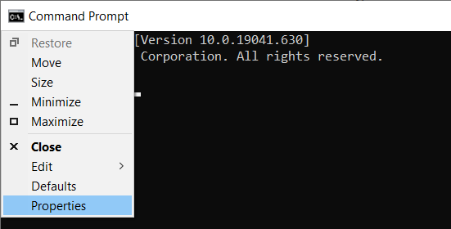
FUN THINGS TO EXPLORE
Customize your CMD

Slide 48
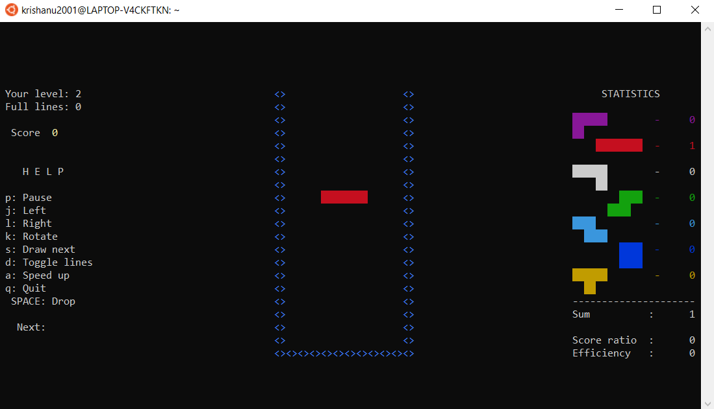
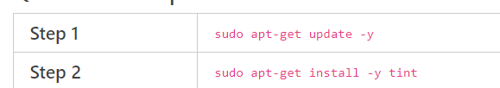
FUN THINGS TO EXPLORE
Using WSL for other purposes!
Let’s play TETRIS

Slide 49
THANK YOU
Somya & Krishanu - The Programming Club
For educational use only

